Slide 1

Presentation by: Eric Boecker, Jordan Heller, Joel Anglin, Jazmarie Hyder

Slide 2
What is Nikto?
Also known as “Nikto2”, is an open source (GPL) web server scanner/analyzer which can perform vulnerability scans against web servers
Scans for potentially dangerous files, outdated versions of servers, and version specific problems on servers
Can be used to run automated scans of web servers and applications checking for additional vulnerabilities such as: the presence of multiple index files, HTTP server options, and identify installed web servers/software

Slide 3
Nikto’s Key Features
Free-to-use and frequently updated
Available on many operating systems such as: Linux, RedHat, MacOSX, Debian, Ubuntu, Solaris, etc
Scans up to 6700+ known vulnerabilities
SSL certificate scanning
Supports multiple ports
Ability to scan through a proxy along with HTTP authentication
Guess credentials for authorization (including many default username/password combinations)
Can export to Metasploit

Slide 4
Scanning
There are multiple syntaxes to run the scan against the web server
The quickest way is
nikto –h $example.com
You can use multiple different plugins
Basic options:
-o, -h, -port, -ssl
-Format msf+

Slide 5
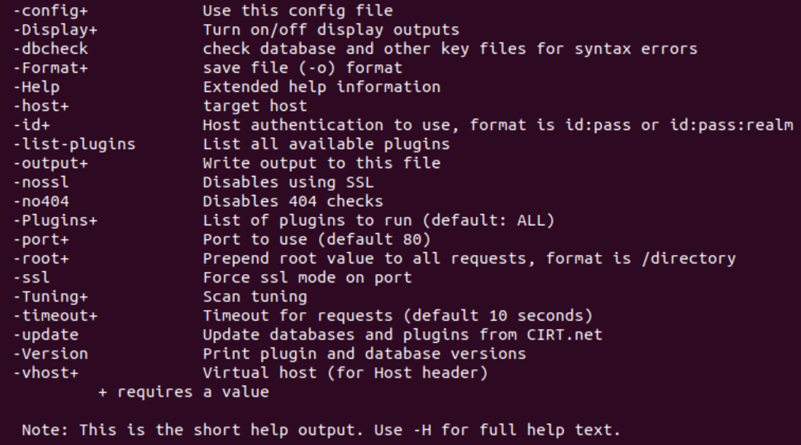
Common Commands to know for Nikto

Slide 6
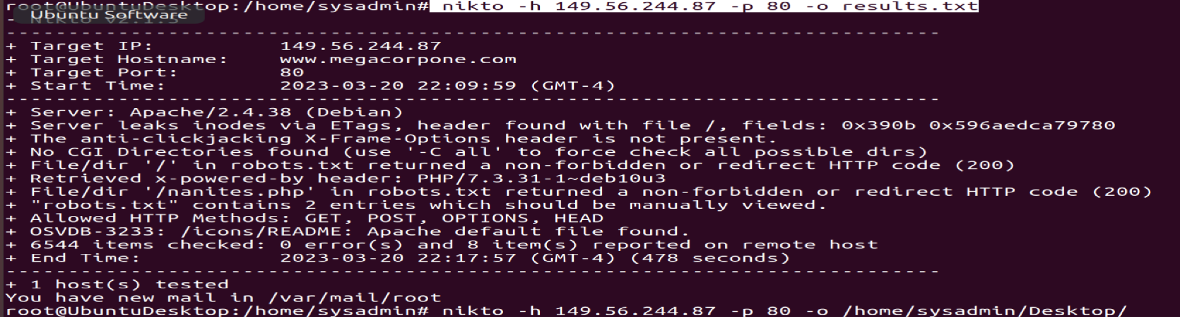
Scan Search examples

Slide 7
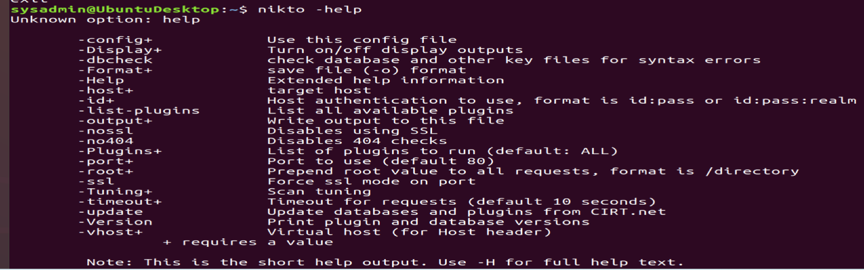
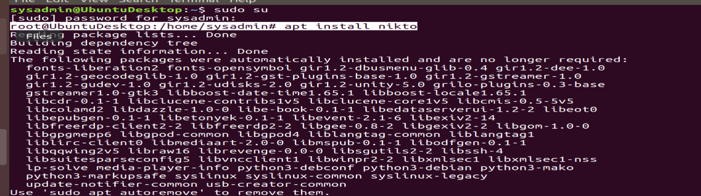
Installing Nikto
Nikto does not come pre-installed on operating systems by default, therefore the command to install Nikto is as follows:
Understanding how to use Nikto simply run this command:

Slide 8
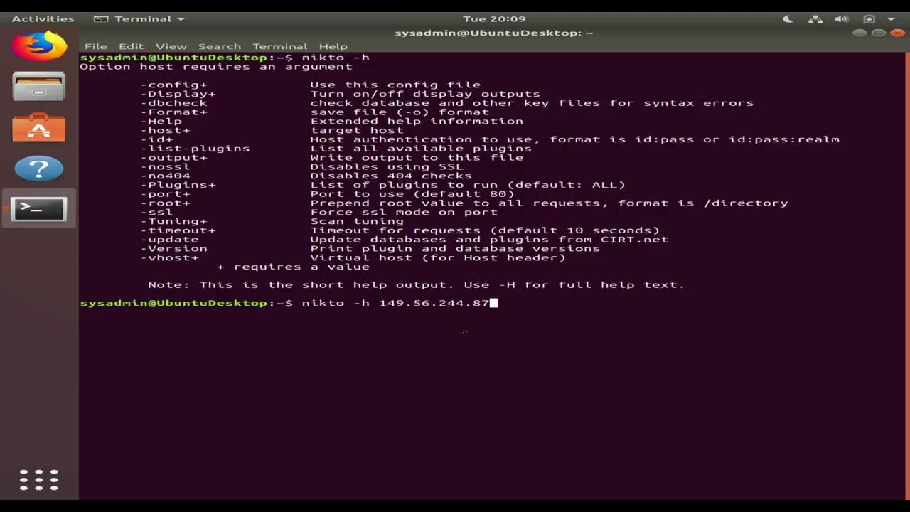
Using nikto basic scan-

Slide 9
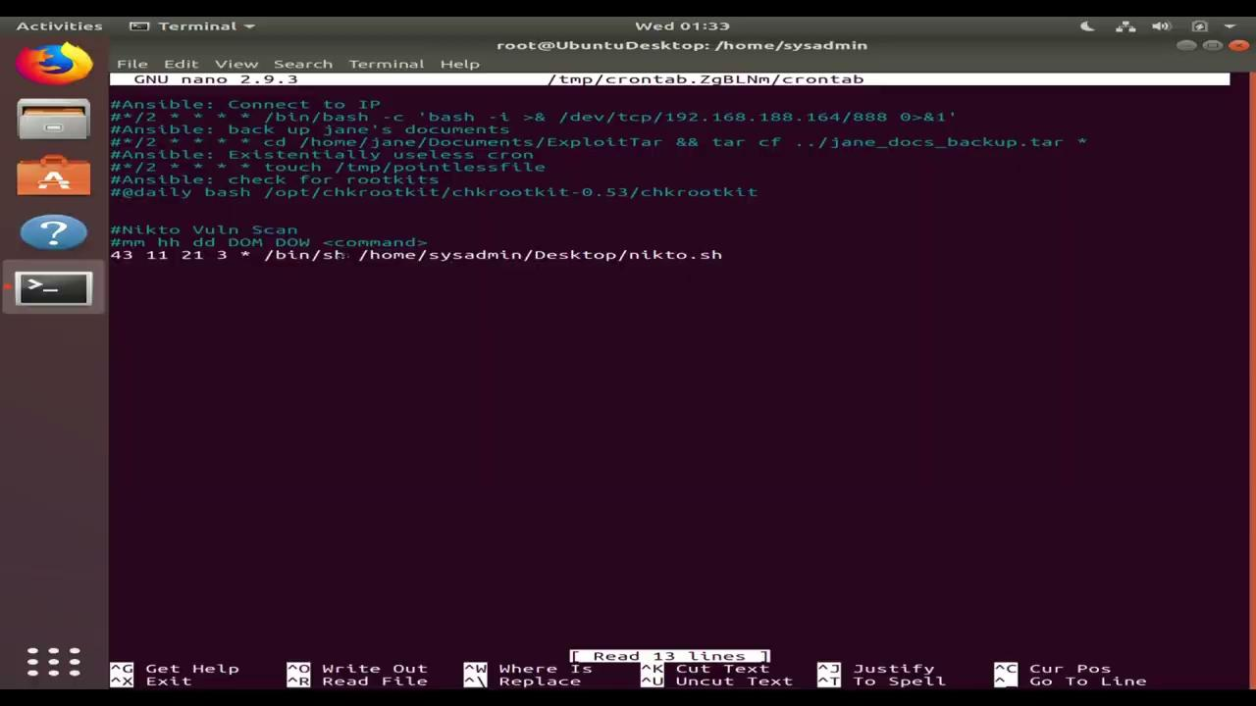
Building an automated schedule to scan daily-

Slide 10
Building an automated scheduling system to run this scan daily
(escalate privileges)
Sudo su
(accessing crontab)
Crontab -e
(inside crontab file)
30 6 * * * /bin/sh /home/user/Desktop/nikto.sh
(go to desktop directory)
nano nikto.sh
(inside nikto.sh file)
Ex. Nikto -h <IP address> -o <name>.html -F html
nikto -h 149.56.244.87 -o /home/sysadmin/Desktop/Vuln_schedule.html -F html
nikto -h 149.56.244.87 -o /home/sysadmin/Desktop/Vuln_schedule.txt -F txt
(making the script executable)
Chmod u+x nikto.sh

Slide 11
Benefits of Using Nikto
Performs over 6700 different tests against a website including SQL injection, Cross-site scripting and Cross-site request forgery
Used to scan Virtual Hosts as well as Websites and Web Servers as well
Is great because it is open sourced and it is often being updated in the GitHub repository
Has many ways built in to evade most security measures
Can directly output results into a file, and even directly to metasploit
Used by a large number of PenTesters

Slide 12
Negatives of Using Nikto
The Scan can take a long time due to all of the different tests.
The Scans are typically very noisy and easy to detect
Many false positives can be found, though they are generally pretty easy to determine
A major problem is that it doesn’t have any form of support
No GUI options, so can only be run using linux or unix-like options
You need to purchase a vulnerability list
Notes:
The false positives are usually either 404 or 200 http messages.

Slide 13
In Conclusion
Notes:
Nikto or as it is commonly known Nikto2 is a great tool that is used by many Penetration testers. It has the ability to perform a vast array of scans on Web servers, and can even be used to target specific ports to search for over 6700 different vulnerabilities. The largest drawbacks are the lack of technical support, and the amount of time the scans can take. Though it is a great tool to have in your pocket to get the job started.

